Slide 1
NEW SOUTH RESEARCH MOCK TRIAL AND LEGAL RESEARCH
INFORMATION OVERVIEW
N E W S O U T H R E S E A R C H | T H E S C I E N C E O F R E A D I N G M I N D S

Slide 2
NEW SOUTH RESEARCH
OVERVIEW
New South Research has been conducting mock trials and legal research since our inception in 1984.
Our range of experience includes research in a variety of cases including sexual harassment, contract disputes, wrongful death, employment discrimination, personal injury and fraud.
Our clients say that the strength of NSR’s approach is that we develop an in-depth understanding of each case by reading the complaint, motions for summary judgement and key witness depositions. We then use that understanding to develop questionnaires that will help identify key arguments, strengths of your case and potential weaknesses.
N E W S O U T H R E S E A R C H | T H E S C I E N C E O F R E A D I N G M I N D S

Slide 3
NEW SOUTH RESEARCH
LEARNINGS
Our goal is to help you and your client gain a better understanding of how jurors will respond to your case.
While examining how jurors respond in your case is the overall objective, our mock trial process will also aid you in understanding a wide range of factors. Specifically, you can potentially answer the following questions:
How do jurors respond to key defense and plaintiff themes?
What do jurors think of the witnesses? Are the witness:
Believable, trustworthy, caring, friendly, approachable, sympathetic, honest?
How do these witnesses compare to New South’s witness database?
How do jurors respond to your case in the current environment?
N E W S O U T H R E S E A R C H | T H E S C I E N C E O F R E A D I N G M I N D S

Slide 4
NEW SOUTH RESEARCH
What exhibits have the most impact in supporting each party?
Are there any exhibits in the case that are confusing?
What do jurors believe about the plaintiff’s request for damages and what do jurors believe is a fair award (if any is to be awarded)?
What demographic and attitudinal factors can be identified that will aid in juror selection?
What demographic groups of jurors show a proclivity to award the greatest amounts in damages?
What internal juror biases affect their perceptions?
How do jurors react to facts that might or might not be admissible at trial?
What internal juror biases affect their perceptions?
How do jurors react to facts that might or might not be admissible at trial?
Do the additional facts sway juror attitudes toward the case?
How do jurors react to the attorneys?
N E W S O U T H R E S E A R C H | T H E S C I E N C E O F R E A D I N G M I N D S

Slide 5
NEW SOUTH RESEARCH
RESEARCH DESIGN
Every case is different and needs a slightly different design. Therefore, we always work with the attorneys to develop a research design that best suits the case and their learning goals.
We do not force a template that does not fit. Our typical research for a one day mock trial design includes the following:
Initial questionnaires that provide a complete background of the jurors, particularly their attitudes, demographics, and experiences. This information will be used to aid in understanding who might be a plaintiff and who might be a defense juror.
Opening statements, witness testimony (prerecorded) and closing statements.
Throughout the proceeding, NSR will distribute prepared questionnaires that evaluate jurors’ feelings about the case, witnesses, and potential verdicts.
Upon completion of presentations, NSR will offer jury instructions and have the jurors complete an individual verdict form.
N E W S O U T H R E S E A R C H | T H E S C I E N C E O F R E A D I N G M I N D S

Slide 6
NEW SOUTH RESEARCH
Jurors will be split into two or three panels for deliberations and completion of a jury verdict form.
Jurors will be lead in a debriefing session by an NSR jury consultant.
Jurors will complete a post deliberation questionnaire to assess key themes.
These extensive juror questionnaires and the debriefing session allow us to build a summary report that is in-depth, actionable and user friendly.
Our final mock trial report has been lauded by our clients as “the best” they have seen and “insightful”. In the report, we will provide the following:
Plaintiff
Key evidence analysis
Examination of influential facts and exhibits
Witness analysis with comparison to our extensive normative database of witness attributes*
Questionnaire analysis
Verdict analysis by numerous demographical and sociological factors
Juror analysis by numerous demographic and sociological factors
Juror’s biographies, their pictures, verdict and supporting quotations
Attorney evaluations, with comparison to our normative database of key attorney attributes*
Supporting appendices
*New South Research has compiled two databases of numerous factors that are essential to a good witness and an effective attorney. This database includes all of the witnesses in all the legal research we have completed. Your witnesses, and the attorneys will be compared to our database on these factors (see attached questionnaire.)
N E W S O U T H R E S E A R C H | T H E S C I E N C E O F R E A D I N G M I N D S

Slide 7
NEW SOUTH RESEARCH
OPTION 1: One Day Full Service Mock Trial
The following is included in the cost:
Cost: $12,500 to $15,500 + incentive cost ($200 - $250 per juror)
Case preparation
Project management
Juror screener to reach appropriate jury pool
Recruiting of 2 jury panels
Creation of in-depth jury questionnaires
Mock court and deliberating rooms
Client viewing facilities
Hosting of the groups
Catering for client and participants
Audio and DVD recording of the proceedings
Moderated discussion led by NSR
Consultant time
In-depth analysis report
Three bound copies of the written analysis report
A one day mock trial can last anywhere from 8 to 10 hours. The time may be broken down as follows (but will be customized to your case):
8:30 AM 9:00 AM Initial Questionnaire-Introduction
9:00 AM 10:00 AM Opening statements and analysis questionnaire
10:00 AM 10:15 AM Break
10:15 AM 12:00 PM Witness or evidence presentation (with analysis questionnaires)
12:00 PM 12:30 PM Lunch
12:30 PM 2:00 PM Witness or evidence presentation (with analysis questionnaire)
2:45 PM 3:30 PM Juror Instructions-Verdict-Break
3:30 PM 5:00 PM Deliberations
5:00 PM 6:00 PM Debriefing and final analysis questionnaire
N E W S O U T H R E S E A R C H | T H E S C I E N C E O F R E A D I N G M I N D S

Slide 8
NEW SOUTH RESEARCH
OPTION 2: Focus Group
This option is ideal when the ultimate goal and simple test of themes intended for presentation at trial. This group allows for attorneys to understand potential juror reactions to the arguments of the case. Furthermore, it can result in an indication of the verdict a jury may render at trial. The cost of the group depends on the involvement of New South. At the low end price, New South will provide screener design, recruiting, a facility, and simple questionnaires. At the higher price, New South will write a summary report.
The basic focus group format takes approximately 4.5 hours, and is broken down as follows:
1.5-2 hours of presentation
30 minute break and questionnaires
1.5-2 hours of discussion
With Option 2 New South Research will be responsible for the following:
Cost: $4,500 to $6,500 + incentive cost ($100 - $150 per juror)
Project management
Juror screener design to reach appropriate screener pool
Recruitment of 1 jury panel
(option for 2 panels)
Hosting of the groups
Audio and DVD recording of proceedings
Client and jurors meals (at additional cost)
Research facility (4.5 hr group)
Simplified questionnaire design
Moderation discussion led by NSR
Summary report (optional)
Extended presentation focus groups are also optional
N E W S O U T H R E S E A R C H | T H E S C I E N C E O F R E A D I N G M I N D S

Slide 9
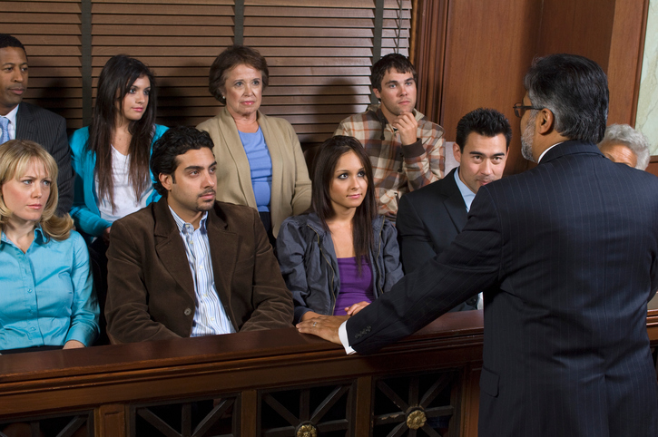
NEW SOUTH RESEARCH
OPTION 3: Do-it-yourself
This option enables attorneys to get a “second look” at their case at a minimal cost.
With this option NSR will manage the process but not participate in questionnaire design, the proceeding or analysis.
NSR will provide the following:
Project management
Recruitment of 12 jurors (option for 24 jurors)
Juror screener design to reach appropriate screener pool
Research facility (4.5 hr group)
Hostess for proceedings
Audio and DVD recordings
Client and juror meals (additional cost)
Cost: $2,950 to $3,950 + incentive cost ($125 - $150 per juror)
N E W S O U T H R E S E A R C H | T H E S C I E N C E O F R E A D I N G M I N D S

Slide 10
NEW SOUTH RESEARCH
ADDITIONAL SERVICES
Two or three day mock trials (longer presentation time for more complex cases)
Extended focus groups (longer presentation time)
Juror selection at trial
Change of venue survey
Evidence-case substantiation survey
N E W S O U T H R E S E A R C H | T H E S C I E N C E O F R E A D I N G M I N D S

